Slide 1
بسم الله الرحمن الرحيم
Arab Organization for Agricultural Development (AOAD)
1st Sub-Regional Forum on Climate Smart Agriculture
Friendship Hall, Khartoum, Sudan
24-26 September 2018
ARC-Sudan Smart Animal Agriculture Innovations and their Practical Implications
Faisal M. El-Hag and Mekki A. Omer
Agricultural Research Corporation (ARC),
Khartoum, Sudan

Slide 2
Introduction
Feeding people in decades to come will require ingenuity and innovations to produce more food on less land in more sustainable ways.
Smart agriculture seeks to:
Improve agriculture management and monitoring systems
Increase sustainable productivity (food security),
Strengthen farmers’ resilience and capacity to resolve technical and environmental problems,
Reduce GHG emissions

Slide 3
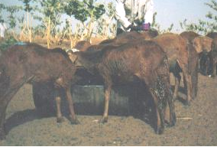
Introduction
Animal Smart Agriculture Practices:
Proven practical techniques,
Integrated crop-livestock management,
Improved animal feeding, and
Improved water management.
Parameters targeted:
Productivity per animal,
Early maturity,
Fertility,
Feed conversion ratio, and
Longevity

Slide 4
Introduction
Baseline surveys indicated:
Unavailability of nutritious grazing feed resources on a year-round-basis,
Water scarcity,
deficiency in major mineral elements (P, Ca and I), and
Diseases
These are reflected in:
High mortalities,
Seasonality of production,
Low fertility, and
Low yields (be milk or weight gains).

Slide 5
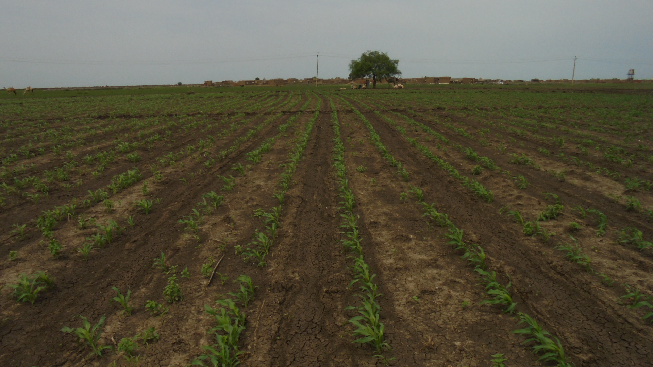
Introduction
This presentation displays ARC-ASARECA Project (conducted at the Central Clay Plains and the Western Sudan Sand Plains sub-watersheds in Sennar and North Kordofan States, 2014-2016) smart agriculture technological innovations on animal production.
The objectives were:
To enhance sustainable agricultural water productivity,
To ensure efficient and sustainable use of available water resources, and
To contribute to the achievement of climate smart agricultural outcomes.

Slide 6
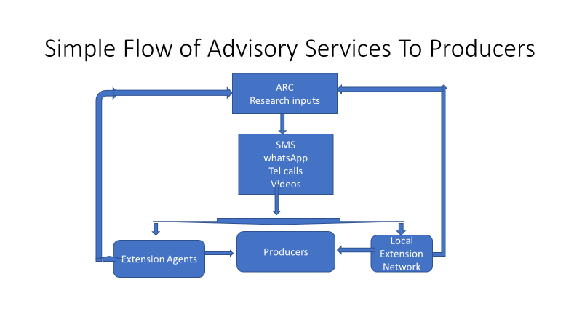
Implementation Modalities
The ARC-ASARECA Project adopted participatory approaches through:
Multidisciplinary teams for technology generation and dissemination
Enhanced involvement of the community members
Organizing farmers into producers’ groups (PGs) for credit arrangement and access facilitation.
Demonstration of closed animal husbandry management system Vs open grazing system
Maximizing farmer income per unit of crop produced and water use through transformation into animal products
Adoption of media tools (videos and filming) for technological packages and smart phone extension services communication with farmers in awareness raising and knowledge dissemination on CSA

Slide 7
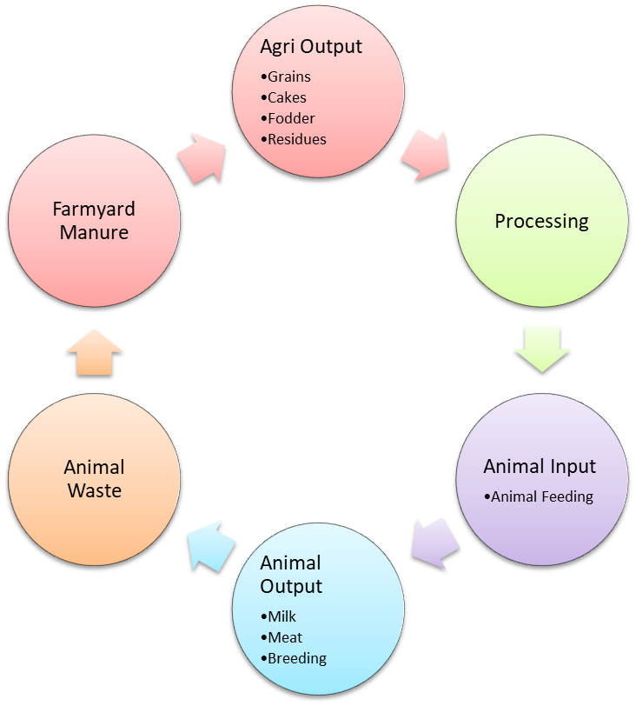
Animal Production Smart Agriculture Packages
A program of value chain on animal nutrition was implemented based on water productivity (use of plant output as input to animal feeding)
Smart Animal Agriculture packages were implemented in 12 communities benefiting 63 animal producers and involving 255 animals
The aim was to increase the output of animal production in terms of:
Milk production (goats and cows),
Animal fattening (lambs) and
Reproductive performance (sheep).

Slide 8
Animal Production Smart Agriculture Packages
Milk production:
Over 100% average increase above the non-supplemented animals.
The feed rations were 200 gm per goat per day and 2 kg per cow per day of oil seed cake.
Net return of US$ 12,140 from 57 goats and US$ 7,793 from 35 cows.
Parameter | Sand plains watershed | Central clay plain watershed
Lactating Goats:
Total number of villages | 5 | 7
Total number of goats | 57 | 35
No. of benefiting households | 22
Feeding period (days) | 45 | 45
Total milk production (litre | 4746.0 | 4701.0
Average daily milk production (litre) | 105.5 | 104.5
Milk price per litre (SDG) | 10.0 | 6.0
Feed cost (SDG) | 2280.0 | 4200.0
Gross income (SDG) | 47470.0 | 28206.0
Net returns (SDG) | 45190.0 | 24006
Lactating Cows (Central clay plains watershed only):
Total number of villages |  | 7
Total number of cows |  | 35
No. of benefiting households |  | 11
Feeding period (days) |  | 45
Total milk production (litre |  | 9270.0
Average daily milk production (litre) |  | 206.0
Milk price per litre (SDG) |  | 6.0
Feed cost (SDG) |  | 11200.0
Gross income (SDG) |  | 55620.0
Net returns (SDG) |  | 44420.0

Slide 9
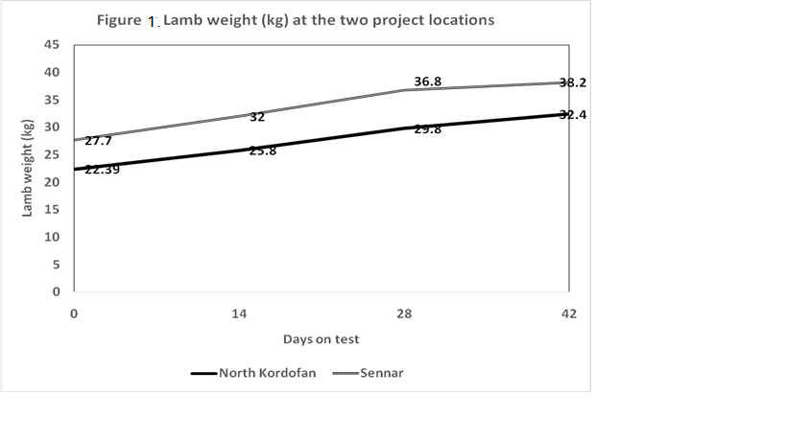
Animal Production Smart Agriculture Packages
Lamb fattening:
High weight gain with low-cost rations at 200 gm/head/day for lambs.
A 180-288 gm daily weight gains over a fattening period (45 days)
Sale prices increased from SDG 400-500 initial prices to as high as SDG 1000-1200 (over 140% increase).
Fattening of 60 lambs (3-6 month old) incurred a net profit of US $ 10,816 to 13 participating producers at US$ 180 per head or US$ 900 per household.

Slide 10
Animal Production Smart Agriculture Packages
Smart Strategic supplementary feeding practices:
Included 68 breeding ewes
benefited 13 producers in Western Sudan Sandy Plains Watershed.
Resulted in improved sheep reproductive performance:
A lambing percent of over 94.0%,
A twining rate of over 35% and
An overall prolificacy (no. of lambs born/ewes exposed) of 1.32.
Reduced age at first conception from 19 mo to 10 mo and lambing at 15 mo instead of 24 mo.
Parameter | value
No. of participating communities | 5
No. of ewes | 68
Lambing rate (%) | 94.0%
No. of lambs born | 90
Twins | 32
Singles | 58
Twining rate (%) | 35.3%
Prolificacy | 1.33

Slide 11
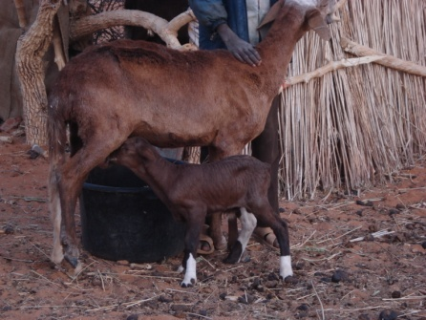
Scaling up modalities
Participatory approaches through a farming system research approach.
Involvement of different partners:
Different stakeholders at stages of program formulation and implementation
Socio-economic activities to define constraints, assess needs
FFS and field days jointly executed and held by extension, research and progressive farmers.
Development projects involvement (e.g. WSRMP, IFAD-BIRDP, IFAD-SUSTAIN, ICARDA,).
Civil society organizations (e.g. farmers and herders’ groups , women groups, etc.) and NGOs.

Slide 12
Challenges and Constraints to scaling-up
Unavailability and accessibility of inputs at the right time and place and at affordable costs.
Poor involvement and participation of policy makers.
Poor involvement of mass media in awareness raising and knowledge dissemination on CSA and high cost
Lack of necessary facilities for extension campaigns (mobility, equipment, extension tools)

Slide 13
Recommendations
Concerted efforts needed to transfer and disseminate smart agriculture technologies, geared at enhancing communities’ livelihoods and income generating options. This could be through:
Multi-disciplinary research teams be formulated for targeting integrated farmers and producers.
Multi-partner participation in technology dissemination guarantees sustainability.
Raising awareness of private sector, policy makers for setting legislations, rules and generating funds
Strengthening the role of the mass media and introduce ICT technologies accelerating timely delivery of extension services, inputs weather and markets to producers.
Availing the necessary inputs.

Slide 14
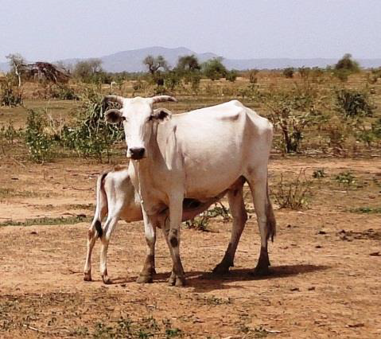
THANKS FOR YOUR ATTENTION

